Slide 1


DISTRIBUTED COMPUTING
Sunita Mahajan, Principal, Institute of Computer Science, MET League of Colleges, Mumbai
Seema Shah, Principal, Vidyalankar Institute of Technology, Mumbai University

Slide 2
Chapter - 9
Naming

Slide 3
Topics
Introduction
Desirable features of a good naming system
Basic concepts
System oriented names
Object locating mechanisms
Issues in designing human oriented names
Name caches
Naming and Security
Case study: Domain Name Service

Slide 4
Introduction

Slide 5
Components of Naming system
Naming mechanism
Locating mechanism

Slide 6
Desirable Features Of A Good Naming System

Slide 7
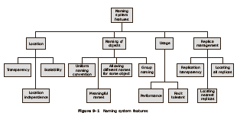
Desirable features of a good naming system

Slide 8
Features of a Good Naming Systems
Location Transparency
Scalability
Uniform naming convention
Meaningful names
Allow multiple user-defined areas
Group Naming
Performance
Fault Tolerance
Location independency
Replication transparency
Locating nearest replica
Locating all replicas

Slide 9
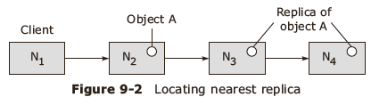
Locating all replicas

Slide 10
Basic Concepts

Slide 11
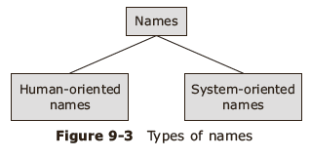
Name
Namespace : The set of names within a distributed system complying with the naming convention

Slide 12
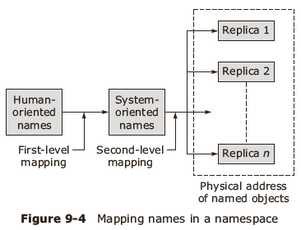
Naming model

Slide 13
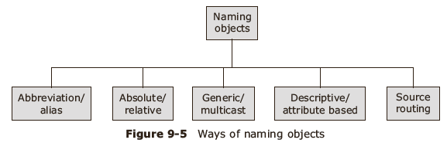
Naming objects

Slide 14
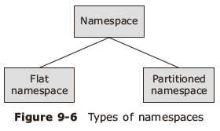
Namespace and contexts

Slide 15
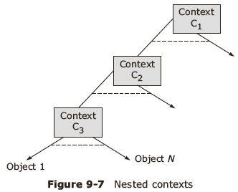
Hierarchical namespace

Slide 16
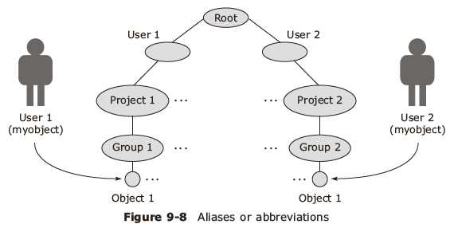
Naming convention for easy access

Slide 17
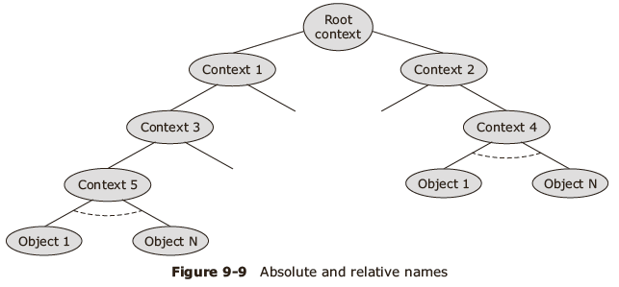
Accessing namespace using current context

Slide 18
Object naming in Hierarchical namespace
Using absolute name
Using a relative name
Changing the current context and then using a relative name

Slide 19
Categories of Names
Generic names
Group or multicast names
Descriptive/ Attribute based names
Source routing name

Slide 20
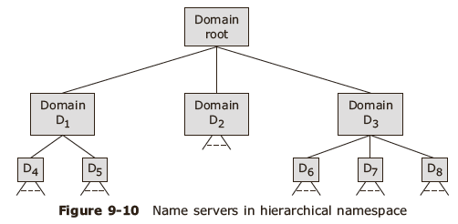
Name server
Name server maintains information about named objects and enables users to access the namespace

Slide 21
Name Agent
Interface between the name servers and clients
Private name agent
  A private name agent works for a single client and is structured as a set of subroutines linked to a client program.
Shared name agent
  A shared name agent is structured as a part of the operating system kernel with system calls to invoke the naming service operations or which can be accessed via IPC primitives.

Slide 22
Name resolution-1
Client contacts the name agent.
Name agent contacts the known name server to locate the object
If object is not located then this known name server contacts the other name servers

Slide 23
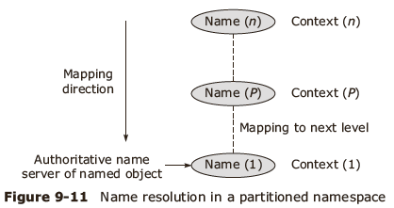
Name resolution-2

Slide 24
System Oriented Names

Slide 25
Features of system oriented names
Integers or bit strings, even as big as 2^128-1
Referred as unique identifiers and do not change during their lifetime
Uniform: of the same size irrespective of the type or location of the object identified by the names.
Easy to perform operations like hashing, sorting etc. on them.
Useful in case of security related situations, hard to crack.
Automatically generated by the system

Slide 26
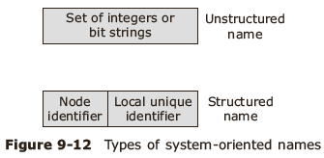
Types of system oriented names

Slide 27
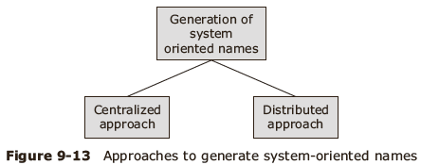
Generating system oriented names

Slide 28
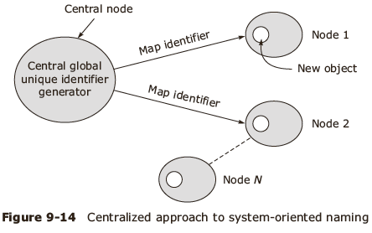
Generating unstructured names

Slide 29
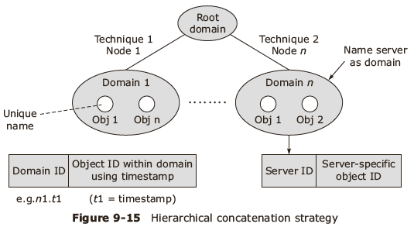
Distributed approach

Slide 30
Generating unique ids
Using timestamp
Using server as domain
Handling system crashes during name generation
  Using clock that operates across failures
  Using multiple levels of storage

Slide 31
Object Locating Mechanisms

Slide 32
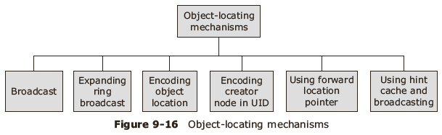
Object locating

Slide 33
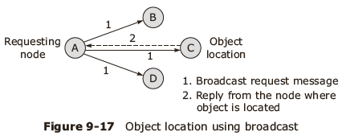
Object location using Broadcast

Slide 34
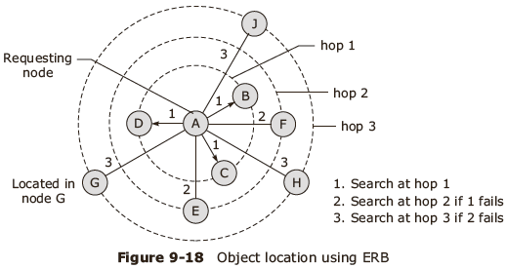
Expanding Ring Broadcast- ERB

Slide 35
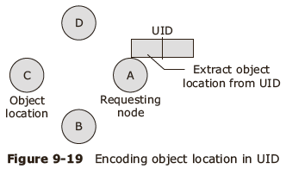
Object location in UID

Slide 36
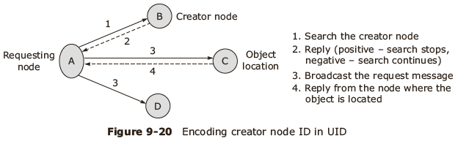
Creator node in UID

Slide 37
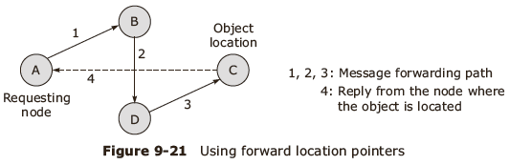
Forward location pointers

Slide 38
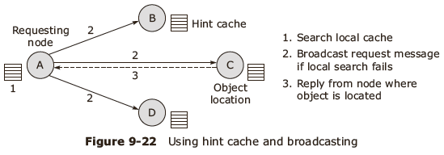
Hint location and broadcasting

Slide 39
Issues In Designing Human Oriented Names

Slide 40
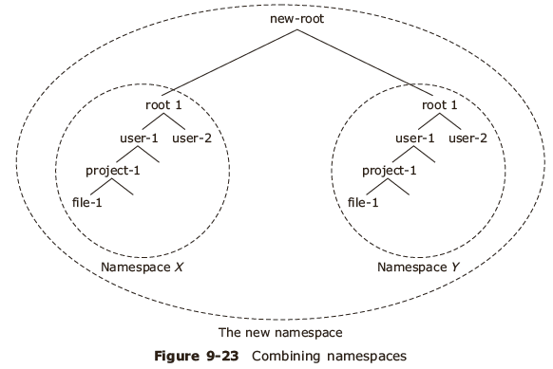
Human oriented names

Slide 41
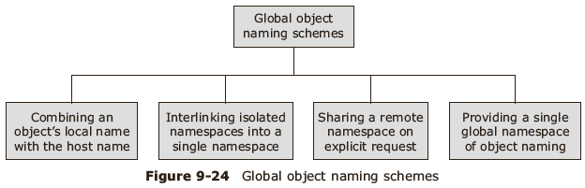
Approaches for global object naming

Slide 42
Scheme for partitioning name space into contexts
Namespace has to be divided among many name servers using the concept of context
Context is an indivisible unit of storage and replication of information regarding named object
Name space is partitioned into contexts by using clustering condition

Slide 43
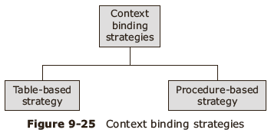
Context binding

Slide 44
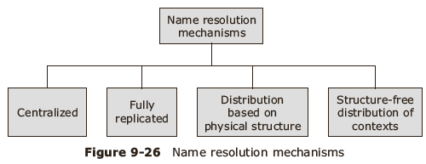
Schemes for name resolution

Slide 45
Name Caches

Slide 46
Characteristics of name service activities
High degree of locality of name lookup
Slow update of name information database
On use consistency of cached information is possible

Slide 47
Issues in Name Cache Design
Types of name caches
Approaches to name cache implementation
Multi-cache consistency

Slide 48
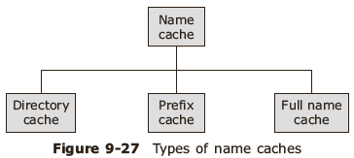
Name caches

Slide 49
Approaches to name cache implementation
A cache per process
A single cache for all processes

Slide 50
Multi cache consistency
Immediate invalidate
On use update

Slide 51
Naming And Security

Slide 52

Naming related access control mechanisms
  Object names as protection keys
  Using capabilities
  Associating protection with name resolution path

Slide 53
Case Study: Domain Name Service

Slide 54
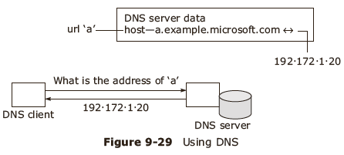
DNS

Slide 55
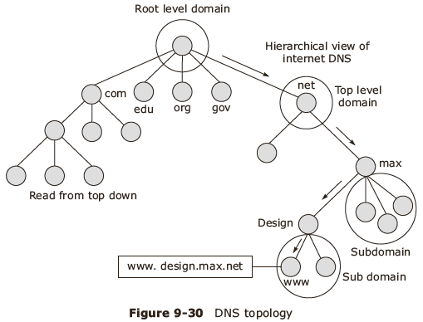
Topology

Slide 56
Summary
Introduction
Desirable features of a good naming system
Basic concepts
System oriented names
Object locating mechanisms
Issues in designing human oriented names
Name caches
Naming and Security
Case study: Domain Name Service

